Slide 1
DATA ANALYSIS
Using SQL
BY ANISH KULKARNI

Slide 2
INTRODUCTION
In the era of smartphones and mobile technology, vast amount of data about smartphones, sensors and other technologies are generated and stored in the database. In a mobile sales dataset typically contains mobile brands, distributor, city, total sales and so on. By data visualizing and analyzing we can get detail insights and find patterns and market performances of a specific region and brand. This data analysis can help to take decisions related to market strategies, product distribution and so on. By doing so, we can optimize sales performance and take decisions of marketing strategies.

Slide 3
Description
The database contains 3 tables which are phone sales table, customer table and mobile table. In Phone sales table we have details of how many smartphones were sold at which country and at what price. It gives details about which mobile brand is selling more than other brands. Next one is Customer table, where there are basic details of customer like first name , last name, email, and by which distributor they purchased it. Last one is Mobile

Slide 4
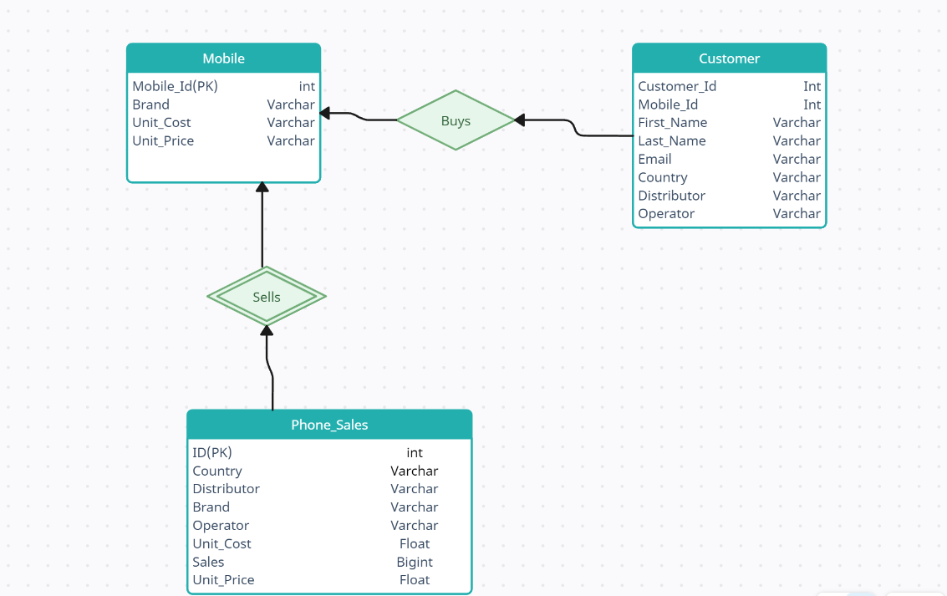

Slide 5
Commands
Create Phone Sales table:-
CREATE TABLE Phone_Sales (
ID INT PRIMARY KEY,
Country VARCHAR(40),
Distributor VARCHAR(50),
Brand VARCHAR(50),
Operator varchar(40),
Unit_Cost FLOAT,
Sales BIGINT,
Unit_Price FLOAT
)
After creating the phone sales table and import the dataset from csv file and it will import the data from csv dile.

Slide 6
Create Mobile table:-
CREATE TABLE Mobile ( Mobile_ID int primary key,
Brand varchar(90),
Unit_Cost Varchar(50),
Unit_Price FLOAT)
Create Customer Table:-
CREATE TABLE Customer ( Customer_ID INT PRIMARY KEY,
Mobile_ID int unique,
First_Name varchar(90),
Last_Name Varchar(50),
Email varchar(90),
Country VARCHAR(40),
Distributor VARCHAR(50),
Operator varchar(40) )

Slide 7
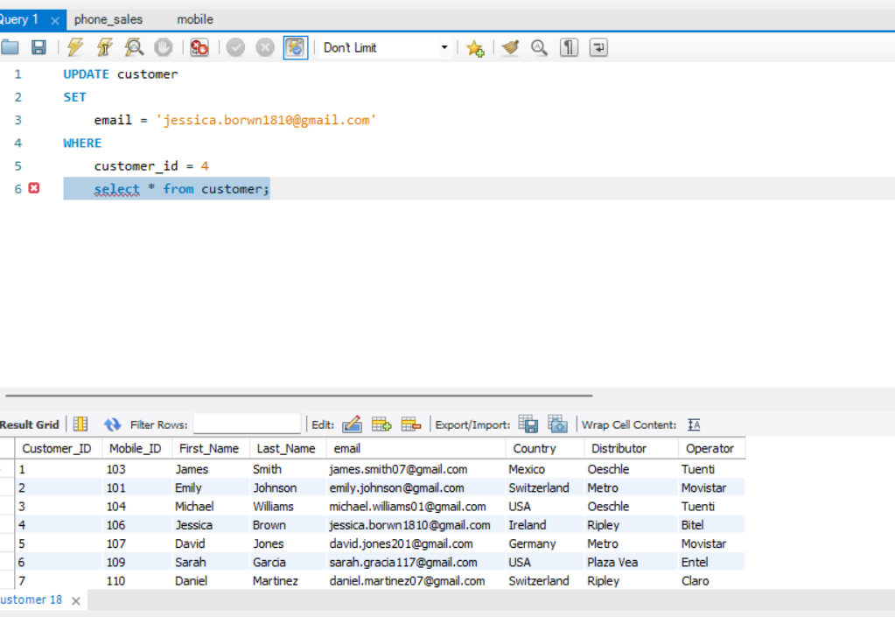
UPDATE COMMAND

Slide 8
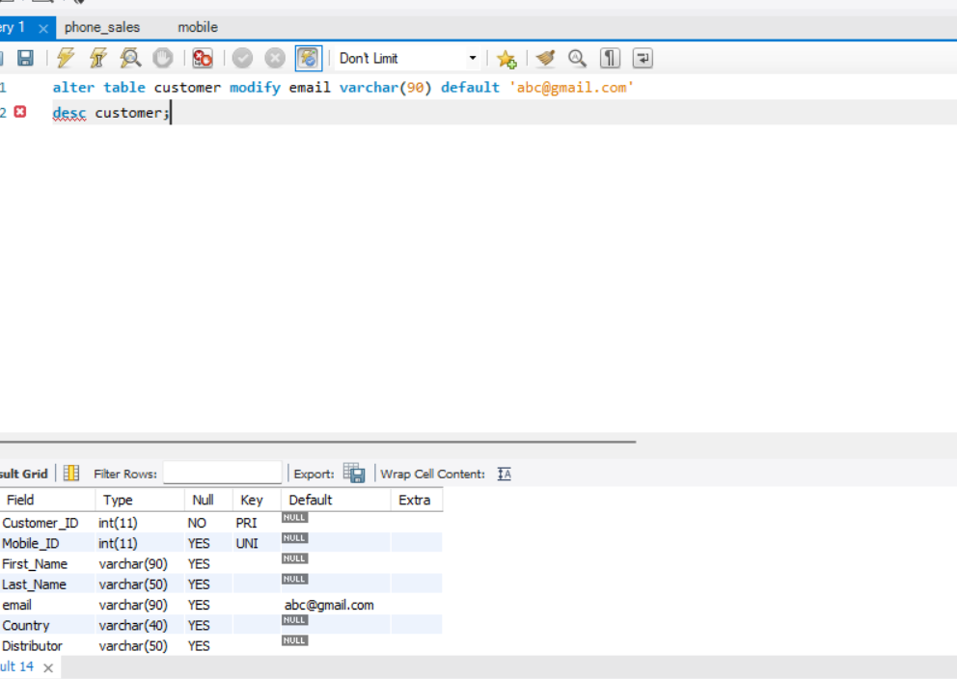
Alter commands

Slide 9
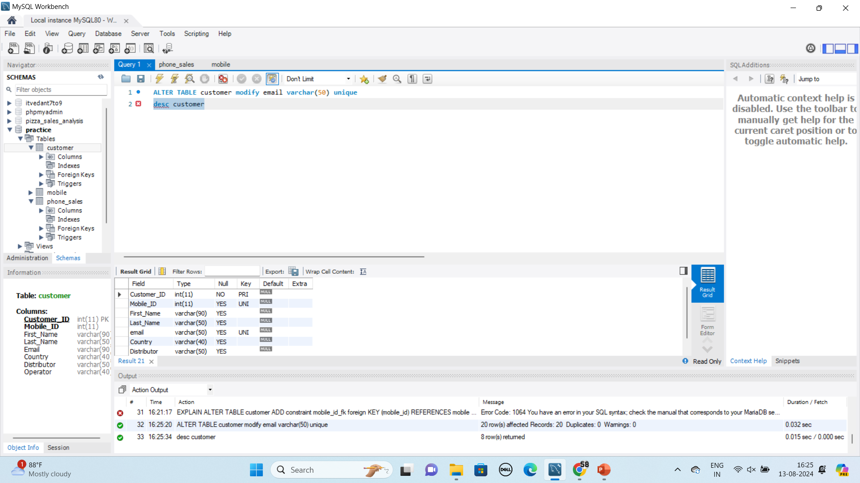

Slide 10
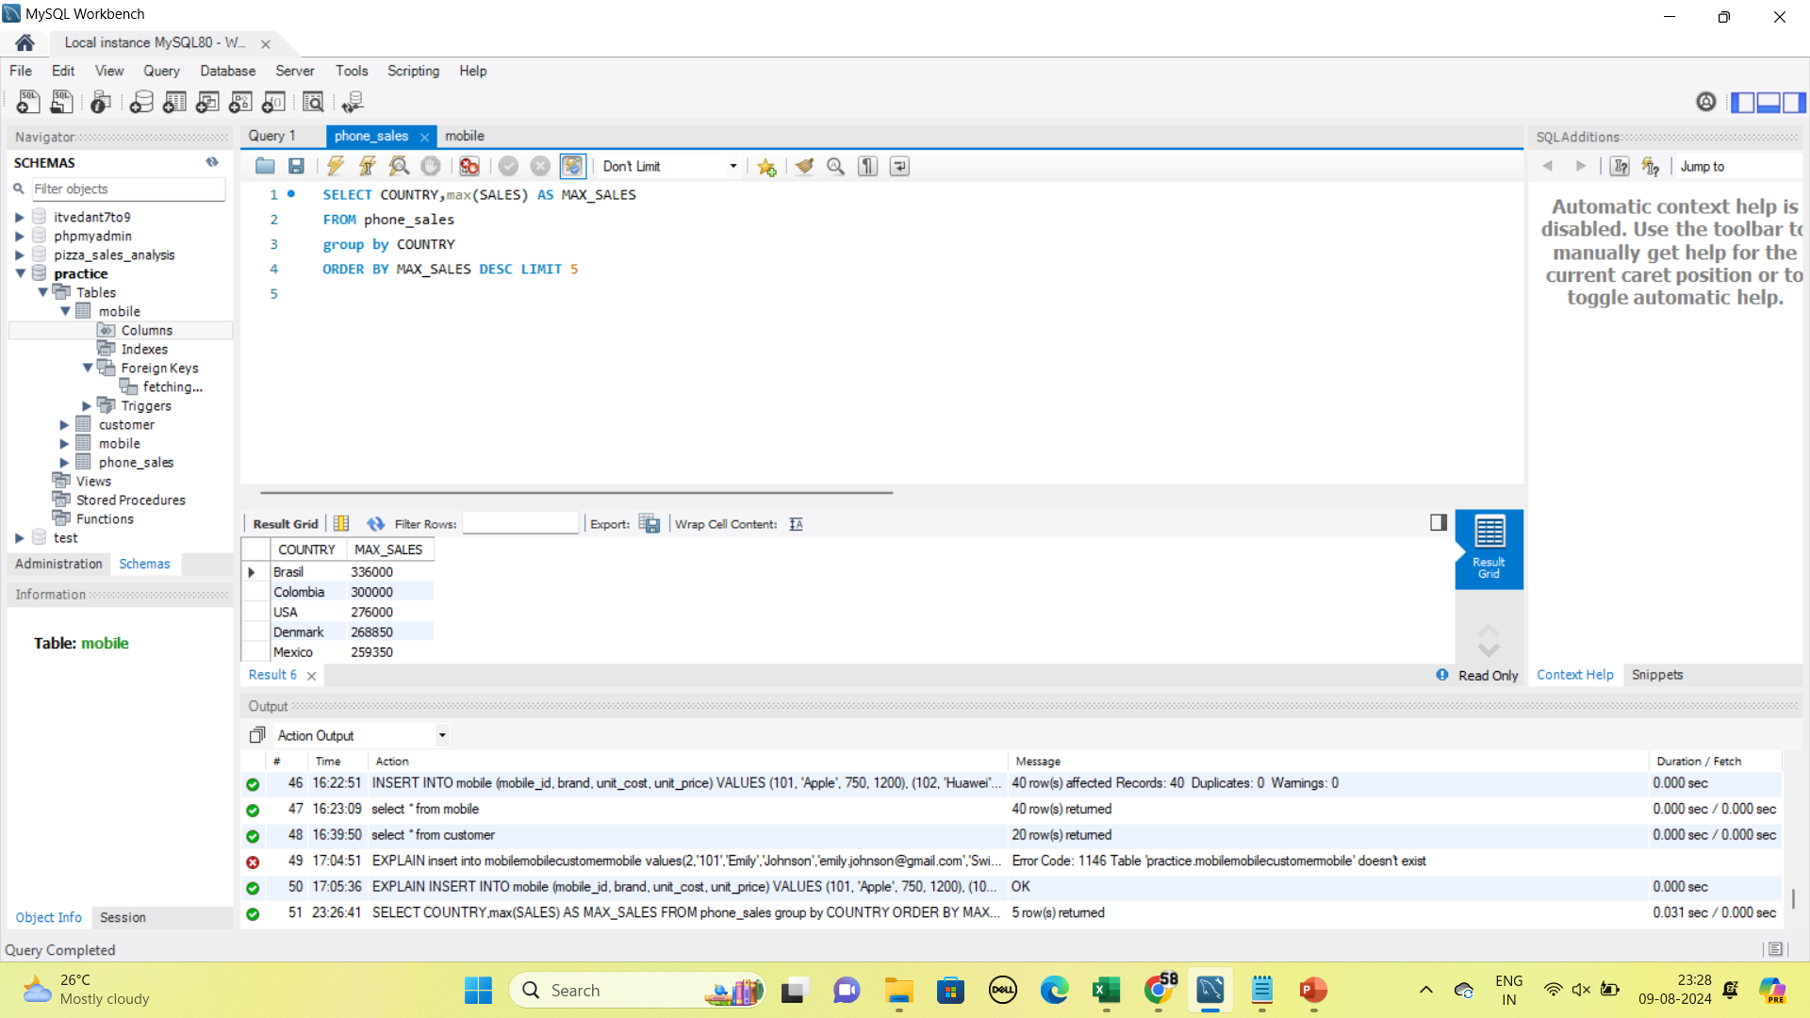
Maximum Sales by country

Slide 12
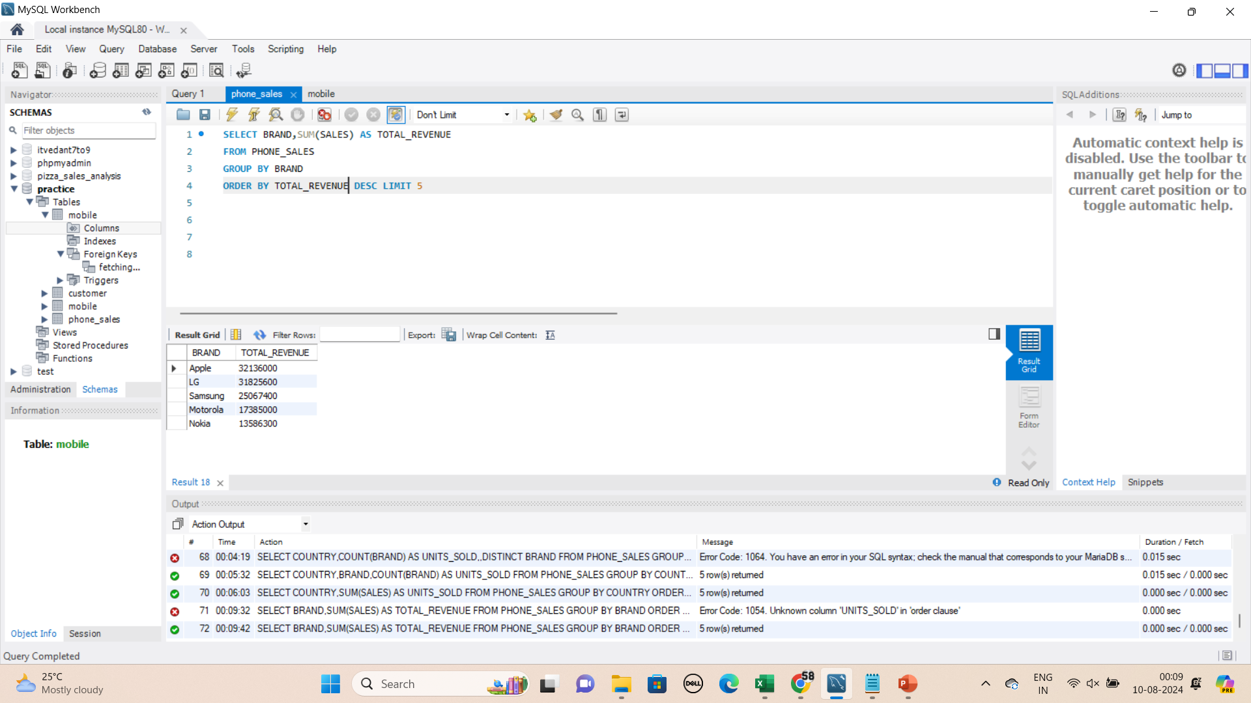
TOTAL REVENUE OF EACH MOBILE BRAND IN DOLLARS

Slide 13
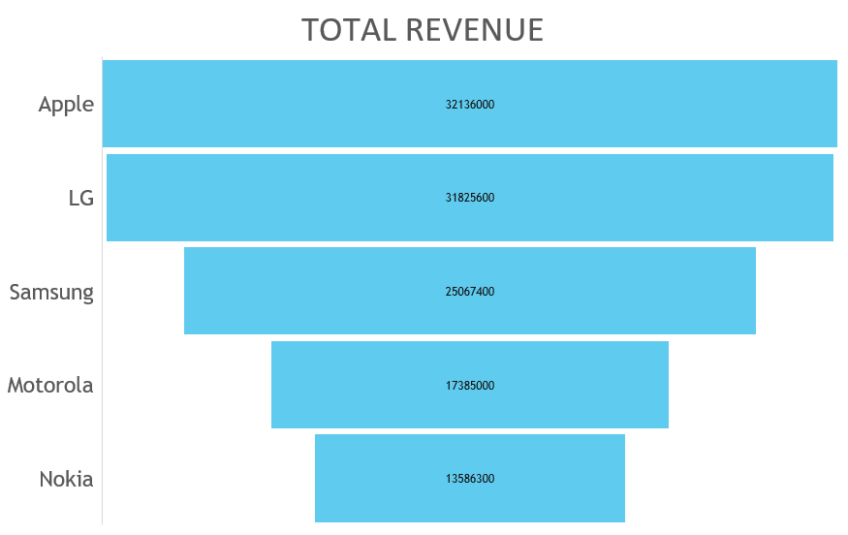

Slide 14
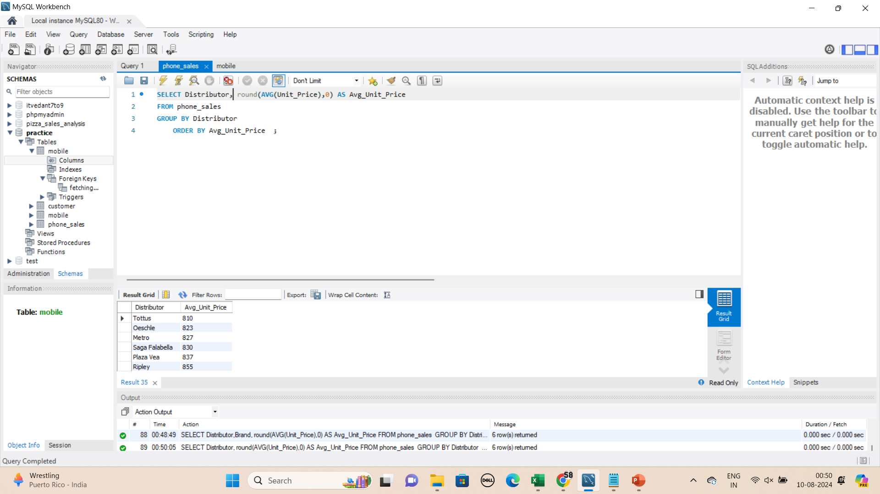
AVERAGE UNIT PRICE OF MOBILE BY DISTRIBUTOR

Slide 15
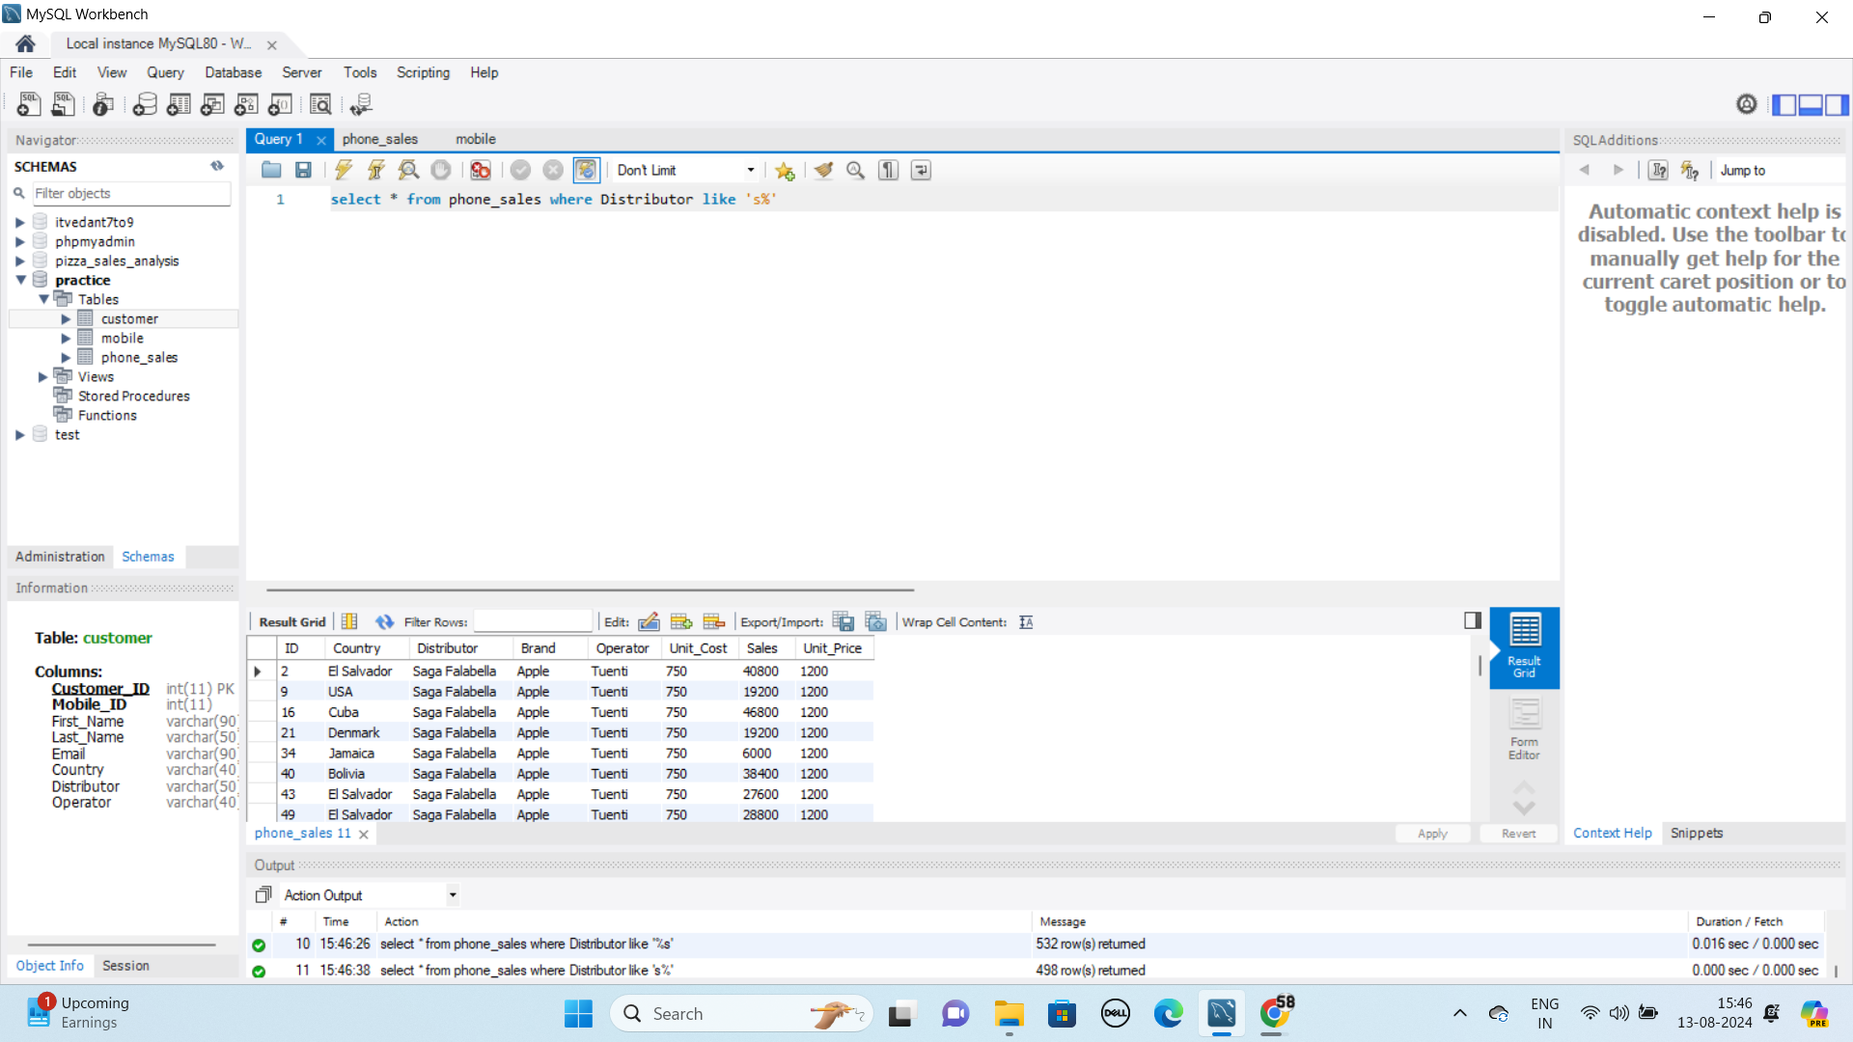
MOBILE SALES & OTHER DETAILS OF DISTRIBUTOR STARTING FROM S ALPHABHET

Slide 16
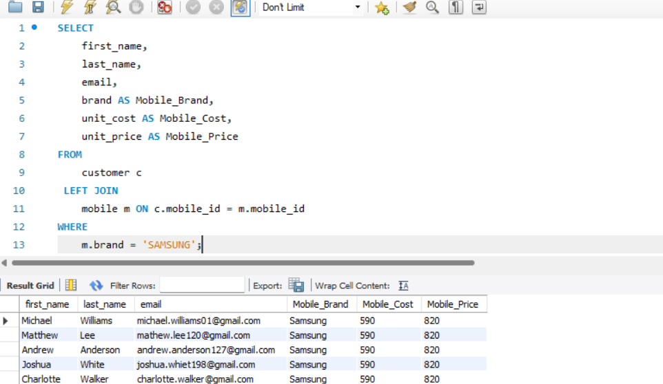
JOINS

Slide 17
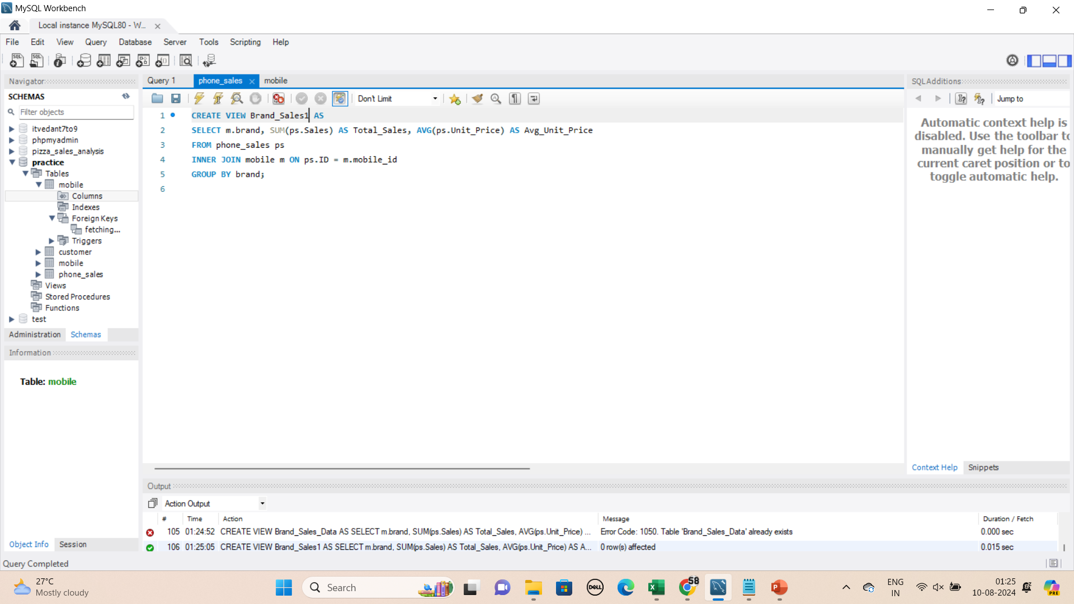
JOINS

Slide 18
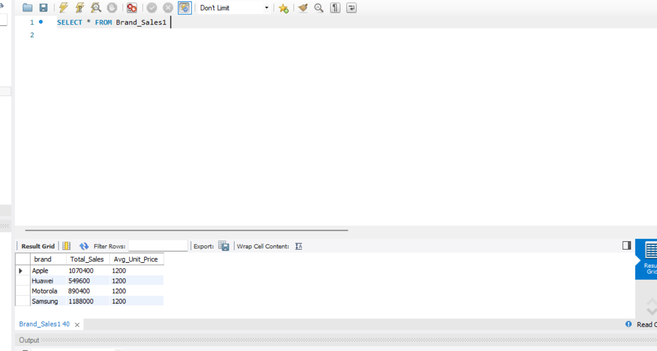
DISPLAYING VIEW OUTPUT

Slide 19
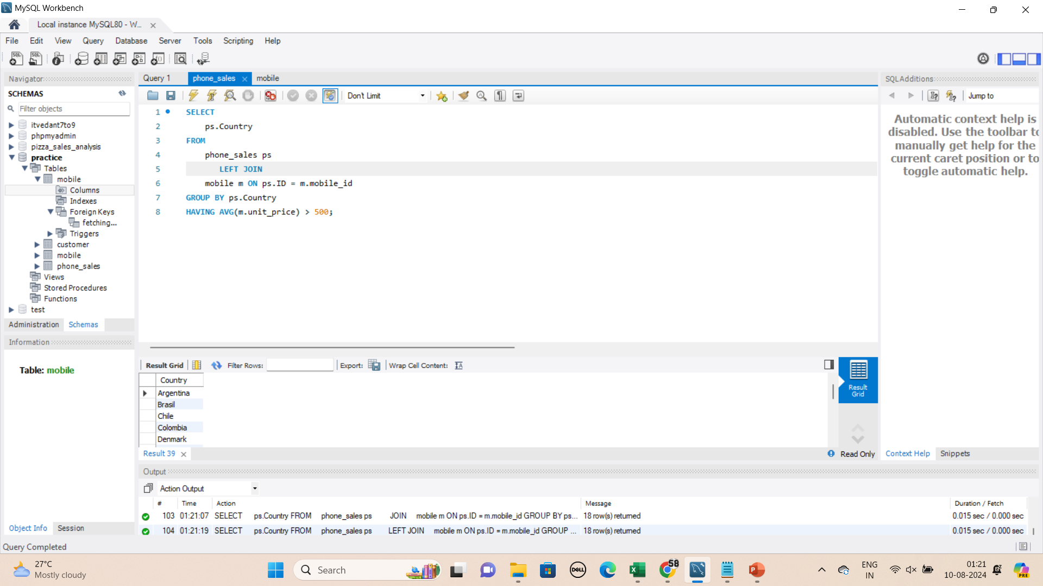
COUNTRIES WHICH HAVE UNIT PRICE OF MORE THAN 500

Slide 20
THANK YOU

